Slide 1



Gesa Credit Union
Problem
Process
Outcome
New financial education portal to encourage user retention and demand generation
Need to improve SEO rankings
Provide additional value to clients and demonstrate value to potential customers
Heuristic evaluations and competitor research
User research, surveys, interviews, focus groups, interaction studies, journey mapping
SEO Research + Content Evaluation
Development of dynamic content site for management by non-technical resources
Launch of new education portal focused on demand gen, SEO rankings, and providing value to customers and potential customers
Employee training on site management and content updates
Fully editable site without need for ongoing support from development teams

Slide 2
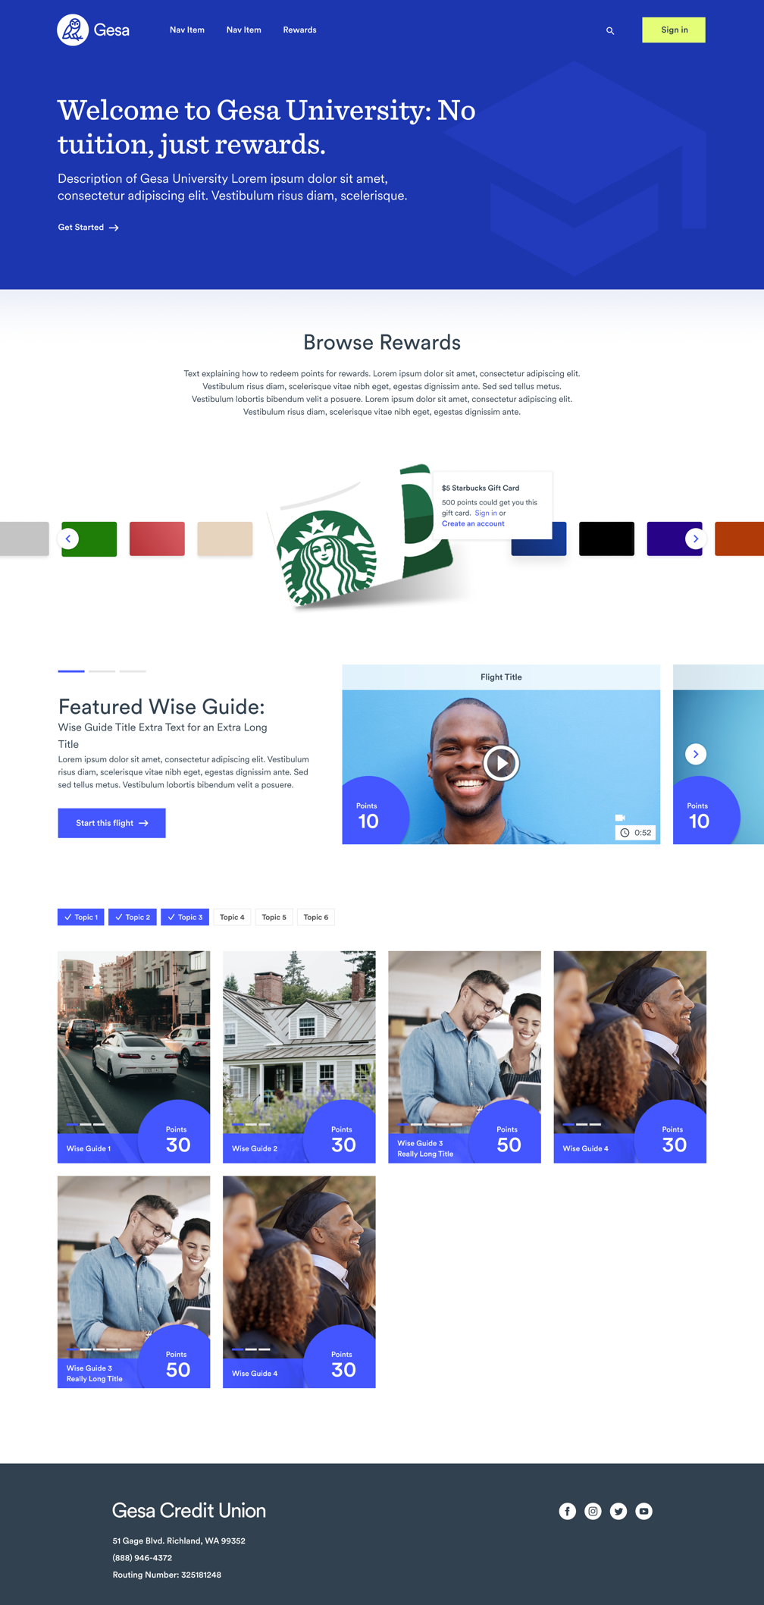
Gesa Credit Union
gesa.com/resources/financial-education
Business Need
GESA was looking to create a new financial education portal so that they could offer content to their members and potential members about personal finance and managing money. The content needed to be easily accessible to anyone on the web, while also having a robust progress tracking system for users who wanted to create logged in accounts.
What We Did
Affirma created an education platform for serving up financial education content. GESA employees are provided a powerful backend for managing dynamic content without help from a developer. We created an education dashboard that displays point information and progress for users when they sign into their account. The Affirma team also put together recommendations for new relevant content to produce for the website.
Results
Affirma successfully launched the new GESA University site meeting GESA’s requirements for a financial education platform. Affirma trained GESA employees on updating and maintaining this new website.

Slide 3
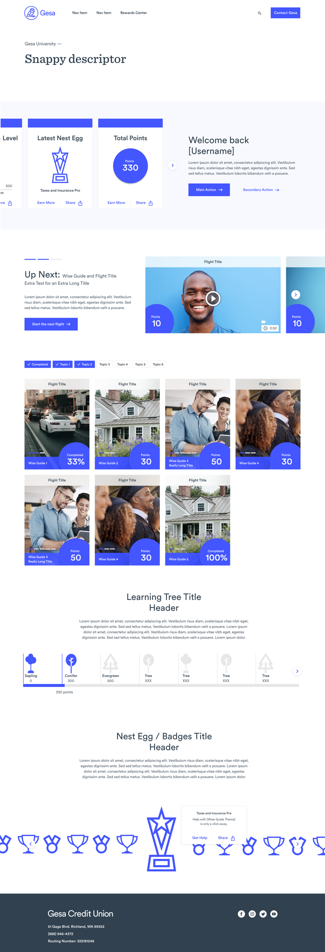

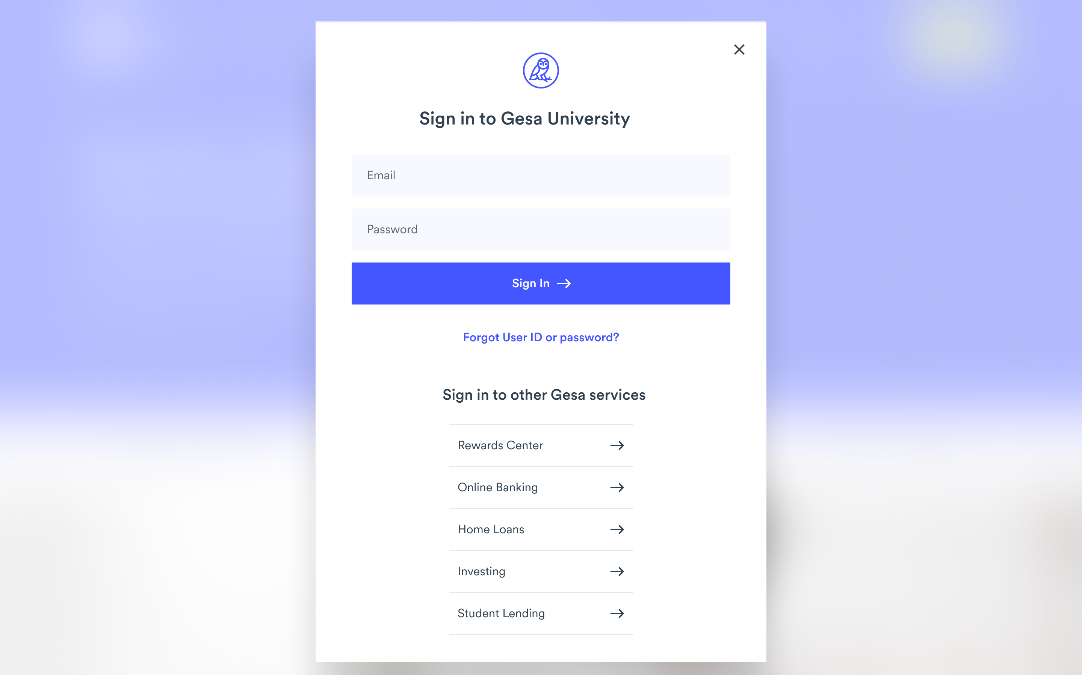
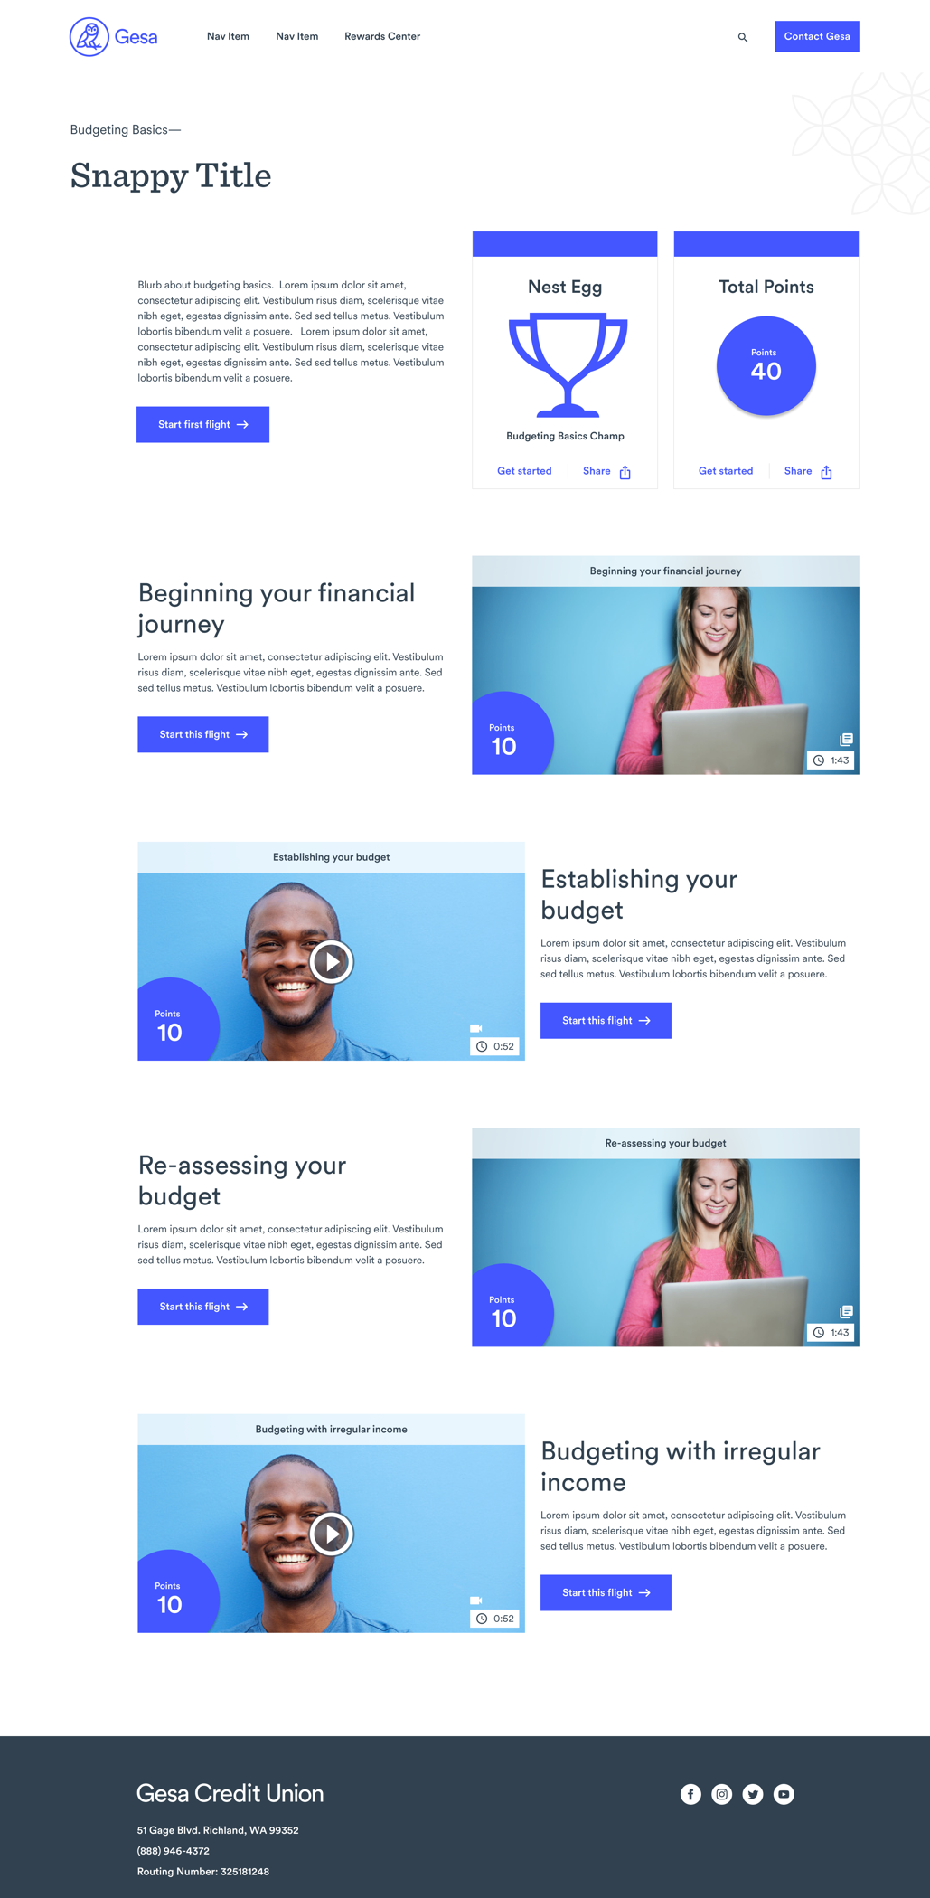
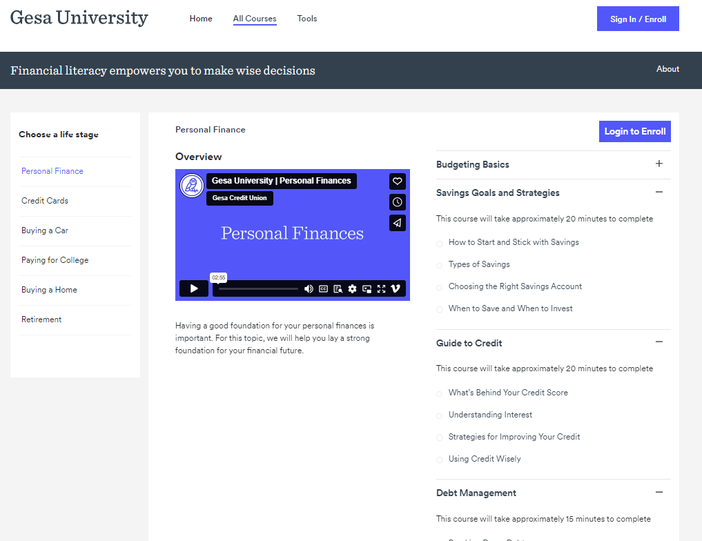
Gesa Credit Union

